Slide 1



JAL JEEVAN MISSION
NABARD CONSULTANCY SERVICES
PROGRESS REPORT
DISTRICT: THANE
KONKAN REGION
JANUARY 2023

Slide 2
District Work Status
Taluka | Category | No. of Schemes | Work Order Issued | Work In Progress | Work Not Started
Dhule | Retro | 51 | 51 | 31 | 20
Sakri | Retro | 132 | 132 | 41 | 91
Shirpur | Retro | 66 | 66 | 47 | 19
Sindkhede | Retro | 13 | 13 | 8 | 5
Grand Total | Retro | 262 | 262 | 127 | 135

Slide 3
Executive Summary Work in Progress Schemes
Taluka | Category | Total No. of Schemes | No. of Schemes based on Physical Progress %
 |  |  | < 25% | 25 < 50% | 50 < 75% | 75 < 100% | Commissioned
Dhule | Retro | 31 | 13 | 7 | 7 | 3 | 1
Sakri | Retro | 41 | 27 | 9 | 3 | 2
Shirpur | Retro | 47 | 17 | 13 | 12 | 3 | 2
Sindkhede | Retro | 8 | 5 | 1 | 1 | 1
Grand Total | Retro | 127 | 62 | 30 | 23 | 9 | 3

Slide 4
Abstract of Schemes – Work in Progress Category – “Retro”
Sr No | Scheme Name | Name of Agency | W.O. Amount (excl GST) | W.O. Date | Construction Period | Physical Progress | RA Bill (Recommended) % | RA Bill (Recommended) In Lakhs
Dhule Taluka | Dhule Taluka
1 | Junawane | Shri Rajendra Patil | 20,76,903 | 12-09-2022 | 6 Months | 82.39% | - | -
2 | Chinchwar | Mohit Nikam | 44,60,874 | 22-09-2022 | 12 Months | 81.37% | 81.13% | 36.19
3 | Sayane | Shri.Vighnaharta Construction | 60,29,891 | 24-08-2022 | 12 Months | 75.28% | 73.44% | 44.28
4 | Kalkhede | Ganesh Borse | 27,88,700 | 22-09-2022 | 12 Months | 73.87% | 73.33% | 20.45
5 | Raver | Lalit Dadasaheb Salunkhe | 11,02,807 | 22-09-2022 | 12 Months | 62.50% | 61.77% | 6.81
6 | Kundane War | Vaibhav Mahajan | 14,40,371 | 14-07-2022 | 6 Months | 62.47% | - | -
7 | Kawathi | Shri.Vighnaharta Construction Shindhkheda | 77,57,746 | 03-02-2022 | 12 Months | 58.40% | 32.44% | 25.17
8 | Gotane | Ganesh Borse | 45,14,330 | 07-03-2022 | 12 Months | 56.87% | 53.34% | 24.08
9 | Anchale Tanda | Shri Kishore Sambhaji Pawar | 62,63,862 | 22-09-2022 | 12 Months | 52.16% | - | -
10 | Satarne | Shri Kishore Sambhaji Pawar | 18,78,753 | 31-01-2022 | 6 Months | 50.38% | - | -
11 | Khede | Shri Jitendra Patil | 39,02,792 | 24-08-2022 | 12 Months | 47.05% | - | -
12 | Mordad Tanda | Shri Kishore Sambhaji Pawar | 56,85,250 | 22-09-2022 | 12 Months | 45.60% | 41.12% | 23.38
13 | Horpada | Abhishek Chinchole | 11,06,520 | 14-03-2022 | 12 Months | 44.00% | - | -

Slide 5
Abstract of Schemes – Work in Progress Category – “Retro”
Sr No | Scheme Name | Name of Agency | W.O. Amount (excl GST) | W.O. Date | Construction Period | Physical Progress | RA Bill (Recommended) % | RA Bill (Recommended) In Lakhs
14 | Deur Bk. | Sharad Deore | 70,91,722 | 19-04-2022 | 12 Months | 31.67% | 31.52% | 22.35
15 | Velhane | Rushikesh Nerkar | 21,61,406 | 19-12-2022 | 12 Months | 30.01% | - | -
16 | Shirdhane Pr. Dangri | Shri Kishore Sambhaji Pawar Dhule | 58,54,129 | 22-09-2022 | 12 Months | 26.49% | 12.20% | 7.14
17 | Sukawad Pr. Dangri | Shri Kishore Sambhaji Pawar | 34,74,340 | 16-03-2022 | 12 Months | 26.15% | 20.55% | 7.14
18 | Burzad | Shramgatha Associates | 95,25,433 | 11-07-2022 | 12 Months | 20.00% | - | -
19 | Chaugaon | Shri.Vighnaharta Construction Shindhkheda | 32,04,453 | 07-09-2022 | 12 Months | 12.93% | - | -
20 | Bendrepada | Shri Kishore Sambhaji Pawar | 42,03,891 | 07-11-2022 | 12 Months | 9.20% | - | -
21 | Nagaon Bk. | Shri Kishore Sambhaji Pawar Dhule | 24,30,626 | 16-12-2022 | 12 Months | 8.00% | - | -
22 | Sonewadi | Ganesh Borse | 38,15,273 | 07-11-2022 | 12 Months | 8.00% | - | -
23 | Deobhane | Girish Marathe | 18,52,212 | 31-01-2022 | 6 Months | 7.88% | - | -
24 | Hendrun | Ganesh Borse | 96,13,779 | 10-06-2022 | 13 Months | 4.02% | - | -
25 | Padalde | Rajendra Vikas Patil | 42,38,637 | 02-12-2022 | 12 Months | 3.00% | - | -
26 | Nandane | Shri.Vighnaharta Construction Shindhkheda | 1,84,99,918 | 08-09-2022 | 12 Months | 2.00% | - | -
27 | Tamaswadi | Sawami Vivekanda Society | 17,40,372 | 16-02-2023 |  | 2.00% | - | -

Slide 6
Abstract of Schemes – Work in Progress Category – “Retro”
Sr No | Scheme Name | Name of Agency | W.O. Amount (excl GST) | W.O. Date | Construction Period | Physical Progress | RA Bill (Recommended) % | RA Bill (Recommended) In Lakhs
28 | Mukati | Mohit Nikam | 26,89,314 | 21-09-2022 | 12 Months | 1.85% | - | -
29 | Lohgad | Shri Vaibhau Mahajan | 14,89,232 | 14-07-2022 | 6 Months | 1.00% | - | -
30 | Behed | Keshar Construction Dhule | 41,70,903 | 21-09-2022 | 12 Months | 0.93% | - | -
Sakri Taluka | Sakri Taluka
31 | Gangapur | Sarsvati Majoor Sahkari Sanstha Pratappur | 14,44,083 | 31-01-2022 | 12 Months | 83.87% | 83.10% | 12.00
32 | Shivajinagar | Sachin Shinde | 36,16,230 | 02-02-2022 | 12 Months | 75.00% | 30.53% | 11.04
33 | Darkhel | Shri Kishore Sambhaji Pawar Dhule | 27,60,749 | 31-01-2022 | 12 Months | 71.03% | - | -
34 | Nawadane | Sachin Society | 19,97,793 | 07-02-2022 | 12 Months | 65.66% | - | -
35 | Phopade | GP | 14,39,705 | 12-10-2022 | 12 Months | 50.00% | - | -
36 | Dhaner | Sushil Desale | 31,26,114 | 27-12-2022 | 12 Months | 44.75% | - | -
37 | Chhavadi | Deepak Chaudary | 79,88,673 | 18-10-2022 | 12 Months | 39.20% | - | -
38 | Gavhanipada | Sushil Desale | 47,35,963 | 18-10-2022 | 12 Months | 35.20% | - | -
39 | Bhadane | Shri Prafful Bedase Nashik | 1,24,87,221 | 12-09-2022 | 12 Months | 30.07% | - | -
40 | Kadupada | Rajendra Pandit Borse | 68,43,675 | 01-10-2022 | 12 Months | 30.00% | - | -

Slide 7
Abstract of Schemes – Work in Progress Category – “Retro”
Sr No | Scheme Name | Name of Agency | W.O. Amount (excl GST) | W.O. Date | Construction Period | Physical Progress | RA Bill (Recommended) % | RA Bill (Recommended) In Lakhs
41 | Kharadbari | Sachin Pandit Shinde | 70,20,946 | 01-10-2022 | 12 Months | 30.00% | - | -
42 | Ranjangaon | Sachin Society | 25,55,641 | 24-01-2023 | 12 Months | 30.00% | - | -
43 | Bhortipada | Shri Sushil Desale Kasare | 59,49,254 | 03-02-2022 | 12 Months | 29.00% | - | -
44 | Chinchpada | Raju Borse | 3,52,22,564 | 12-10-2022 | 12 Months | 25.00% | - | -
45 | Rohod | Sachin Shinde | 29,14,039 | 25-04-2022 | 12 Months | 21.91% | - | -
46 | Ghodade | Deepak Chaudary | 25,60,718 | 31-01-2022 | 9 Months | 21.32% | - | -
47 | Jaitane | Jitendra Patil | 4,01,07,614 | 29-11-2022 | 12 Months | 16.45% | - | -
48 | Kalambhir | Sharad Deore | 48,51,355 | 27-06-2022 | 12 Months | 16.33% | - | -
49 | Petale | Shri Vighnhatra Construction | 23,91,522 | 27-07-2022 | 12 Months | 16.03% | - | -
50 | Lonkhedi | Sushil Dattatray Desale Kasare | 75,86,321 | 16-12-2022 | 12 Months | 15.00% | - | -
51 | Umbhare | Rajendra Desale | 29,54,160 | 18-10-2022 | 12 Months | 12.73% | - | -
52 | Bhagapur | Arun Patil | 24,46,782 | 29-12-2022 | 12 Months | 10.00% | - | -
53 | Degaon | Shri Sushil Desale Kasare | 47,57,225 | 18-10-2022 | 12 Months | 10.00% | - | -
54 | Dighave | Sushil Desale | 22,37,992 | 01-10-2022 | 12 Months | 10.00% | - | -

Slide 8
Abstract of Schemes – Work in Progress Category – “Retro”
Sr No | Scheme Name | Name of Agency | W.O. Amount (excl GST) | W.O. Date | Construction Period | Physical Progress | RA Bill (Recommended) % | RA Bill (Recommended) In Lakhs
55 | Pobare | Shri Sushil Desale Kasare | 75,69,956 | 24-08-2022 | 12 Months | 10.00% | - | -
56 | Vasmar | Sharad Anantrao Deore | 98,99,641 | 16-12-2022 | 12 Months | 10.00% | - | -
57 | Jebapur | R.V Desale | 39,92,902 | 30-01-2023 | 12 Months | 9.18% | - | -
58 | Khandbara | Ganesh Borse | 1,18,10,493 | 16-12-2022 | 12 Months | 9.00% | - | -
59 | Malpur | Kautubh Patil Dhule | 12,84,957 | 10-02-2022 | 12 Months | 9.00% | - | -
60 | Nandarkhi | Ganesh Borse | 64,89,052 | 10-01-2022 | 12 Months | 5.87% | - | -
61 | Jambhore | Sushil Desale | 28,82,919 | 18-10-2022 | 12 Months | 5.00% | - | -
62 | Nandvan | Rajendra Desale | 63,93,856 | 18-10-2022 | 12 Months | 5.00% | - | -
63 | Nawapada | Sachin Shinde | 88,39,994 | 07-03-2022 | 12 Months | 5.00% | - | -
64 | Mohane | Shri Vighnhatra Construction | 1,15,70,683 | 20-12-2022 | 12 Months | 4.00% | - | -
65 | Perejpur | Jitendra Patil | 94,73,558 | 29-11-2022 | 12 Months | 3.89% | - | -
66 | Vitai | Mayur Mahajan | 20,51,596 | 22-09-2022 | 6 Months | 2.82% | - | -
67 | Pankheda | Shri Vicky Kokani Ambapada | 14,22,001 | 31-03-2022 | 12 Months | 2.00% | - | -
68 | Virkhel | Sushil Desale | 48,33,390 | 27-12-2022 | 12 Months | 2.00% | - | -

Slide 9
Abstract of Schemes – Work in Progress Category – “Retro”
Sr No | Scheme Name | Name of Agency | W.O. Amount (excl GST) | W.O. Date | Construction Period | Physical Progress | RA Bill (Recommended) % | RA Bill (Recommended) In Lakhs
69 | Ashtane | Sushil Desale | 61,10,133 | 16-12-2022 | 12 Months | 1.00% | - | -
70 | Umarpata | Abhijit Rathod | 1,01,83,351 | 29-11-2022 | 12 Months | 0.99% | - | -
71 | Pratappur | Man Mohhan Singh Rajput | 19,09,321 | 28-06-2022 | 6 Months | 0.77% | - | -
Shirpur Taluka | Shirpur Taluka
72 | Higaon | Narendra Sahebrao Patil | 19,20,570 | 31-01-2022 | 12 Months | 90.00% | - | -
73 | Savalde | Shri Kishore Sambhaji Pawar | 21,17,331 | 19-04-2022 | 12 Months | 87.02% | 59.27% | 12.55
74 | Godi | Shri Kishore Sambhaji Pawar | 29,74,029 | 04-11-2022 | 12 Months | 75.00% | 33.50% | 9.96
75 | Ambe | Balaji Infrastructure Arthe B. | 4,26,63,100 | 14-03-2022 | 12 Months | 70.36% | - | -
76 | Ajnad | Chandrashekhar Rajput | 21,63,617 | 05-08-2022 | 12 Months | 64.10% | 54.91% | 11.88
77 | Londhare | Shramgatha Associates Malegaon | 88,13,690 | 22-09-2022 | 12 Months | 62.37% | - | -
78 | Kharikhan | Shri Rajendra Patil | 19,30,957 | 13-10-2022 | 12 Months | 62.30% | 28.33% | 5.47
79 | Untawad | Narendra Sahebrao Patil | 21,26,940 | 19-04-2022 | 12 Months | 59.39% | 59.15% | 12.58
80 | Vikharan Bk. | Sarsvati Majoor Sahkari Sanstha Pratappur | 21,28,875 | 07-03-2022 | 12 Months | 59.15% | 58.95% | 12.55
81 | Chandpuri | Ganesh Borse | 79,67,677 | 01-09-2022 | 12 Months | 59.10% | 58.38% | 46.52

Slide 10
Abstract of Schemes – Work in Progress Category – “Retro”
Sr No | Scheme Name | Name of Agency | W.O. Amount (excl GST) | W.O. Date | Construction Period | Physical Progress | RA Bill (Recommended) % | RA Bill (Recommended) In Lakhs
82 | Vadel Kh | Shri Kishore Sambhaji Pawar | 19,29,000 | 15-03-2022 | 12 Months | 58.00% | - | -
83 | Kadhaipani | Shri Ketan L Patil | 17,00,843 | 21-10-2022 | 9 Months | 57.00% | - | -
84 | Bharvade | Ganesh Borse | 34,09,278 | 24-04-2022 | 12 Months | 56.76% | 53.13% | 18.11
85 | Rudawali | Durgadas Pawar | 23,70,775 | 14-03-2022 | 12 Months | 52.38% | - | -
86 | Umarda | Ketan Patil | 17,00,843 | 12-10-2022 | 12 Months | 50.00% | 49.49% | 8.42
87 | Ajande Bk. | Mohit Nikam | 42,22,495 | 22-09-2022 | 12 Months | 48.28% | 48.04% | 20.28
88 | Arthe Bk. | Md Infrastructure | 1,14,77,906 | 27-06-2022 | 15 Months | 46.19% | - | -
89 | Arthe Kh. | Md Infrastructure | 1,21,43,722 | 27-06-2022 | 15 Months | 44.97% | - | -
90 | Gartad | Shri Vighnhatra Construction | 35,28,737 | 03-02-2022 | 12 Months | 41.02% | - | -
91 | Gidhade | Shri Vighnhatra Construction | 20,21,882 | 29-04-2021 | 12 Months | 39.42% | - | -
92 | Jalod | Shramgatha Associates Malegaon | 56,75,335 | 25-03-2021 | 12 Months | 35.77% | - | -
93 | Kalamsare | Shri Kishore Sambhaji Pawar | 35,79,204 | 04-02-2022 | 12 Months | 35.64% | - | -
94 | Taradi | Durgesh Patil | 19,84,333 | 02-05-2022 | 12 Months | 34.83% | 33.15% | 6.58
95 | Waghadi | Narendra Sahebrao Patil | 47,13,481 | 19-04-2022 | 12 Months | 34.26% | - | -

Slide 11
Abstract of Schemes – Work in Progress Category – “Retro”
Sr No | Scheme Name | Name of Agency | W.O. Amount (excl GST) | W.O. Date | Construction Period | Physical Progress | RA Bill (Recommended) % | RA Bill (Recommended) In Lakhs
96 | Vakwad | Shri Vighnhatra Construction | 50,24,298 | 14-03-20222 | 12 Months | 33.50% | 32.81% | 16.48
97 | Tarhadi Taraf Tarhad | Shri Vighnhatra Construction | 1,07,59,011 | 08-09-2022 | 12 Months | 31.80% | 30.87% | 33.21
98 | Bhatane | Narendra Sahebrao Patil | 1,04,72,486 | 05-08-2022 | 12 Months | 31.76% | - | -
99 | Kalapani | Dhandai.M.Sah.Khalane | 29,45,324 | 26-09-2022 | 12 Months | 26.71% | - | -
100 | Subhash Nagar | Narendra Sahebrao Patil | 74,14,485 | 04-11-2022 | 12 Months | 24.53% | 17.81% | 13.21
101 | Bhoiti | Shri Vighnhatra Construction | 50,57,000 | 14-03-2022 | 12 Months | 12.30% | - | -
102 | Kurkhali | Krishna Sonwane | 19,75,000 | 02-05-2022 | 12 Months | 11.03% | - | -
103 | Wathode | Ganesh Borse | 34,07,000 | 21-11-2022 | 12 Months | 10.43% | - | -
104 | Panakhad | Shri C. G. Rajput | 55,35,000 | 29-11-2022 | 12 Months | 10.00% | - | -
105 | Bhortek | Ganesh Borse | 21,14,000 | 01-09-2022 | 12 Months | 8.32% | - | -
106 | Tande | Sagar Pawar | 45,81,000 | 20-12-2022 | 12 Months | 6.00% | - | -
107 | Ahilyapur | Shri Kishore Sambhaji Pawar Dhule | 60,20,000 | 22-09-2022 | 12 Months | 5.81% | - | -
108 | Kakadmal | Dhandai.M.Sah.Khalane | 18,85,000 | 16-12-2022 | 12 Months | 5.00% | - | -
109 | Karvand | Shri Nilesh Nile | 43,80,000 | 10-11-2022 | 12 Months | 4.21% | - | -

Slide 12
Abstract of Schemes – Work in Progress Category – “Retro”
Sr No | Scheme Name | Name of Agency | W.O. Amount (excl GST) | W.O. Date | Construction Period | Physical Progress | RA Bill (Recommended) % | RA Bill (Recommended) In Lakhs
110 | Nandarde | Akash Nikam | 19,55,000 | 28-11-2022 | 12 Months | 4.00% | - | -
111 | Hingonipada | Kamlesh Patil | 22,22,000 | 28-11-2022 | 12 Months | 3.46% | - | -
112 | Jatoda | Deomogra Adiwasi Society Joyada | 21,37,000 | 05-08-2022 | 12 Months | 2.78% | - | -
113 | Bhatpura | Shri Vighnhatra Construction | 37,18,000 | 08-09-2022 | 12 Months | 2.00% | - | -
114 | Hated | Shri Kishore Sambhaji Pawar | 39,33,606 | 12-10-2022 | 12 Months | 2.00% | - | -
115 | Hingoni Bk. | Girish Thakre | 27,94,000 | 24-01-2023 | 12 Months | 2.00% | - | -
116 | Zendeanjan | Ganesh Borse | 66,24,000 | 07-11-2022 | 12 Months | 0.01% | - | -
Sindkhede Taluka | Sindkhede Taluka
117 | Valkhede | Durgadas Pawar | 54,90,705 | 22-09-2022 | 12 Months | 99.02% | 24.06% | 13.21
118 | Langhane | Narendra Sahebrao Patil | 48,51,329 | 31-10-2022 | 12 Months | 54.86% | - | -
119 | Zotwade | Gaurav.M.Sah.Sau.Khalane | 28,27,285 | 07-03-2022 | 12 Months | 38.34% | 37.66% | 10.65
120 | Shendwade | Shri Kishore Sambhaji Pawar | 28,41,878 | 28-11-2022 | 12 Months | 24.59% | - | -
121 | Bhilane D. | Dhandai.M.Sah.Sau.Khalane | 15,09,255 | 06-10-2022 | 12 Months | 22.93% | - | -
122 | Amalthe | Manish Pawar | 76,92,991 | 11-11-2022 | 12 Months | 5.00% | - | -

Slide 13
Abstract of Schemes – Work in Progress Category – “Retro”
Sr No | Scheme Name | Name of Agency | W.O. Amount (excl GST) | W.O. Date | Construction Period | Physical Progress | RA Bill (Recommended) % | RA Bill (Recommended) In Lakhs
123 | Hispur | Nilesh Nile | 14,87,736 | 31-10-2022 | 6 Months | 2.00% | - | -
124 | Humbarde | Pawan Dilip Pawar | 24,89,729 | 29-12-2022 | 12 Months | 2.00% | - | -

Slide 14
Abstract of Schemes – Work Completed Category – “Retro”
Sr No | Scheme Name | Name of Agency | W.O. Amount (excl GST) | W.O. Date | Construction Period | Physical Progress | RA Bill (Recommended) % | RA Bill (Recommended) In Lakhs
Dhule Taluka | Dhule Taluka
1 | Borkund | Shri Kishore Sambhaji Pawar Dhule | 17,34,034 | 31-01-2022 | 6 Months
Shirpur Taluka | Shirpur Taluka
2 | Gurhadpani | Dhandai.M.Sah.Sau.Khalane | 20,34,287 | 24-03-2022 | 12 Months
3 | Hivarkheda |  | 19,06,616 |  | 12 Months

Slide 15
DASHBOARD

Slide 16
Dashboard
Work Status

Slide 17
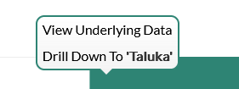
Dashboard
Progress Milestone

Slide 18
Dashboard
Work Status:
Work Status: Taluka Wise

Slide 19
MS – PROJECT
Work in Progress Schemes

Slide 20
Project Overview Physical Progress vs Financial Progress vs Time Overrun

Slide 21
Late Schemes

Slide 22
SAMPLE SITE VISIT PHOTOS

Slide 23
, Tal.

Slide 24
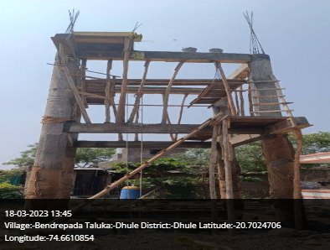
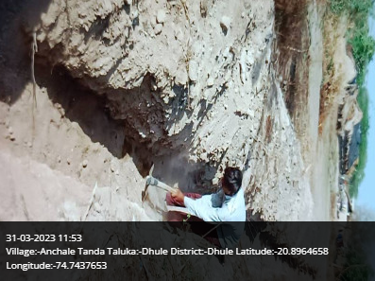
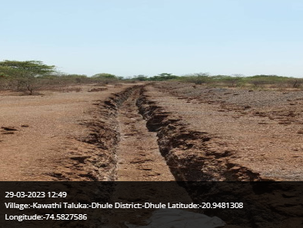
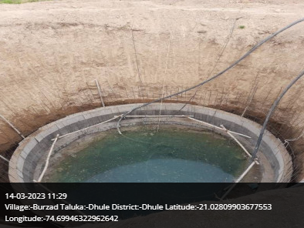
Dhule Taluka

Slide 25
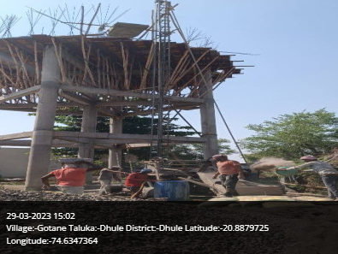
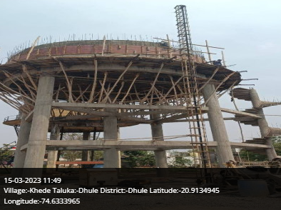
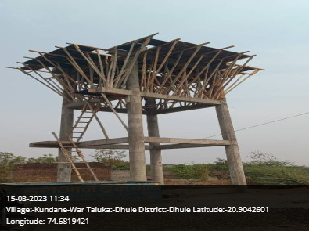
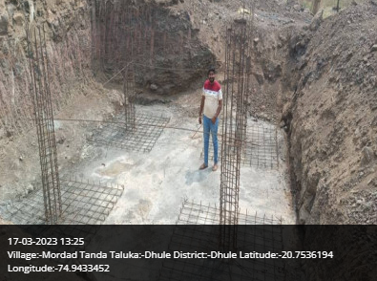
Dhule Taluka

Slide 26
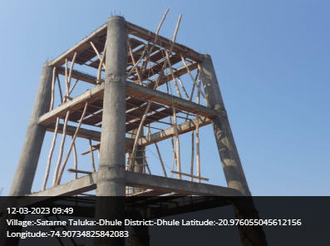
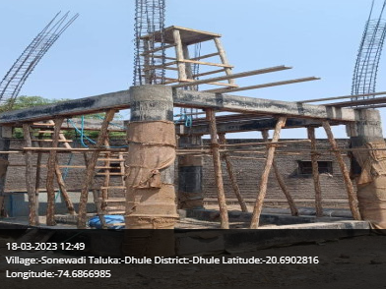
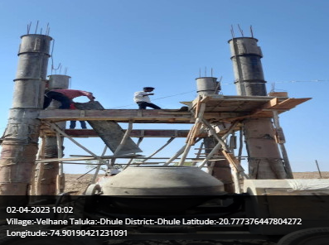
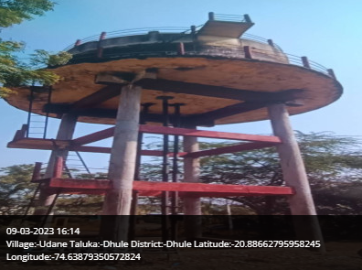
Dhule Taluka

Slide 27
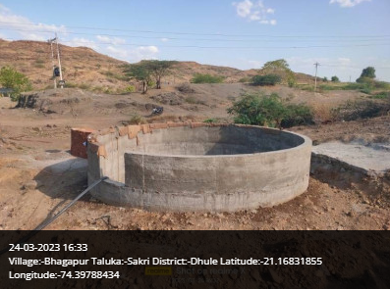
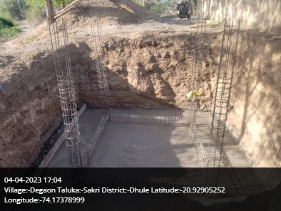
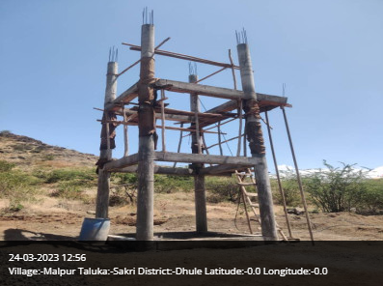
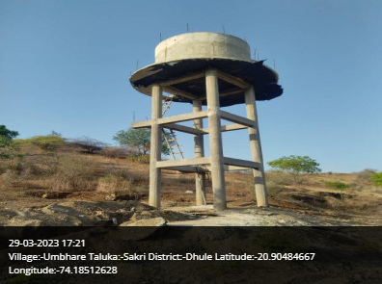
Sakri Taluka

Slide 28
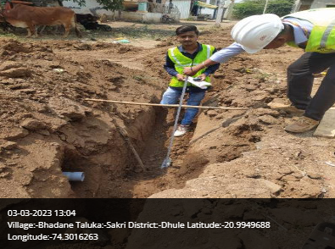
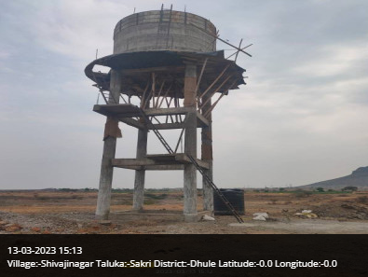
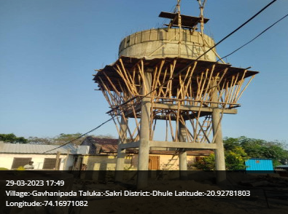
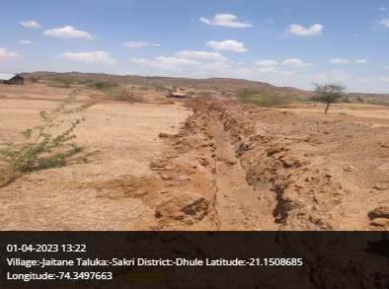
Sakri Taluka

Slide 29
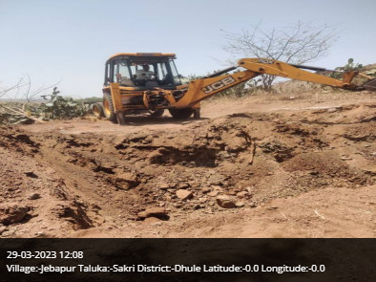
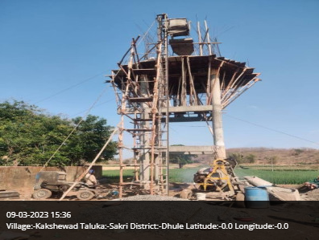
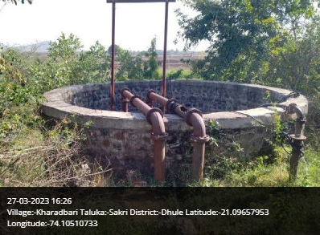
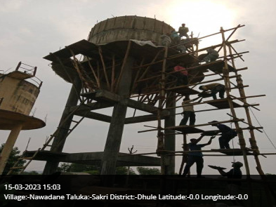
Sakri Taluka

Slide 30
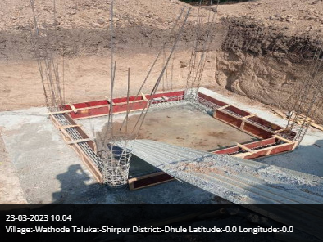
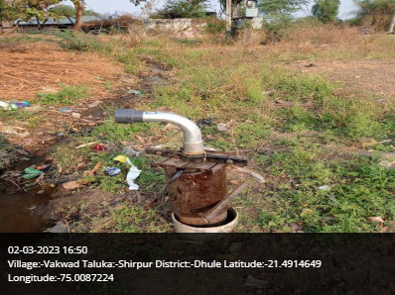
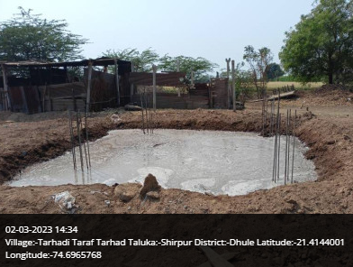
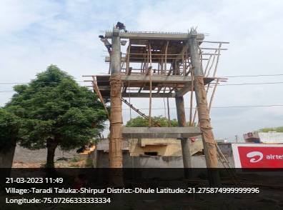
Shirpur Taluka

Slide 31
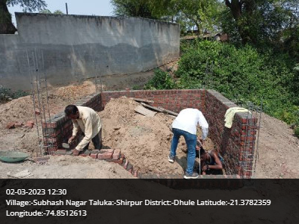
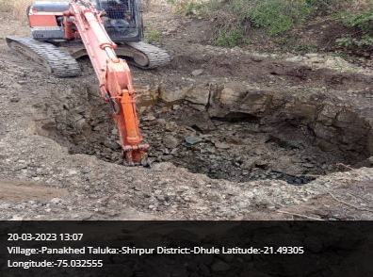
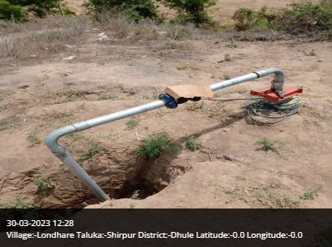
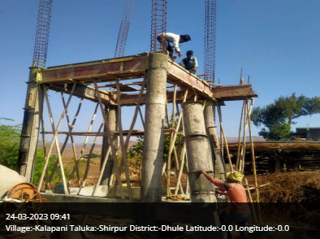
Shirpur Taluka

Slide 32
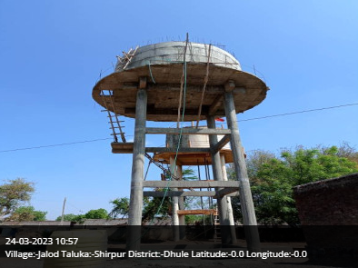
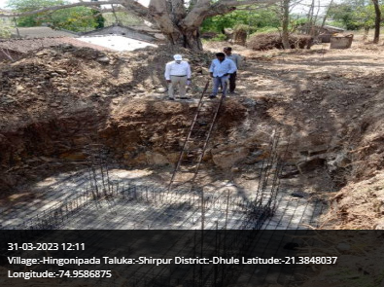
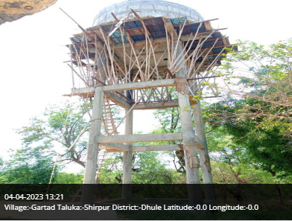
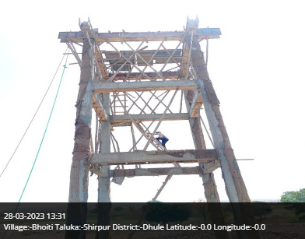
Shirpur Taluka

Slide 33
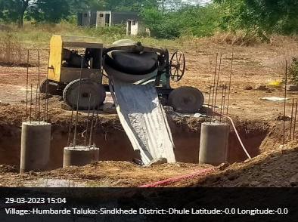
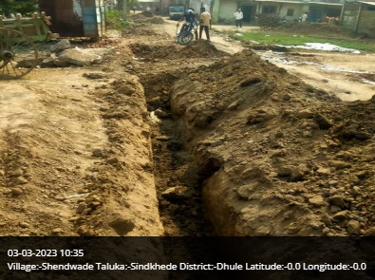
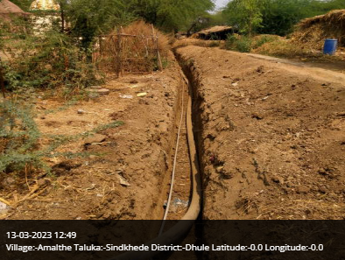
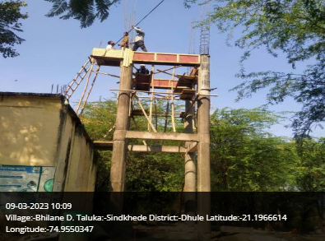
Sindhede Taluka

Slide 34

Thank You!

